Slide 1

Diversity Equity and Inclusion
One small step toward social justice.

Slide 2
Diversity Equity and Inclusion
“Our latest research finds that companies in the top quartile for gender or racial and ethnic diversity are more likely to have financial returns above their national industry medians… And diversity is probably a competitive differentiator that shifts market share toward more diverse companies over time.”
(McKinsey & Co., “Why Diversity Matters”, Hunt, Layton, and Prince 2015)

Slide 3
Diversity Equity and Inclusion
Asset $ in billions

Slide 4
Positive screening for Diversity Equity and Inclusion
Collaboration with MRTI:
Multiple conversations with Rob Fohr and Katie Carter
Using same database as MRTI: ISS
Met with ACWC, REAC, and MRTI leadership in late January
Meeting with MRTI in March
Focus is to assist MRTI with DEI criteria and to discuss a DEI investment vehicle
The objective is to improve and align criteria with MRTI, create awareness and support with MRTI

Slide 5
What this fund is…
This fund is a solution for investors looking to invest according to the Presbyterian values of diversity, equity and inclusion that are consistent with GA guidance administered by MRTI.
What this fund is not…
This fund is not everything that needs to be done in this area. It is, in our view, additive to the overall efforts being applied across many areas and is effective in drawing corporate attention to investor demands.
This fund is not a full replication index of the market and does not include international stocks or very small cap stocks.

Slide 6
Use of Negative Screening that includes MRTI Guidance
Includes all companies on the MRTI Divestment/Proscription List:
Removes firms engaged in alcohol, tobacco, weapons, gambling, for-profit prisons, and other social rights offenders

Slide 7
Use of positive screening for Diversity, Equity and Inclusion!
Positive Screening conditions:
Using ISS ESG screening technology to develop a score for firms and their progress on critical diversity, equity, inclusion and ESG criterion.
This includes numerous MRTI positive screen data points to sort out the best of breed securities representing sectors and industries in line with the allocation within the Russell 3000 index.

Slide 8
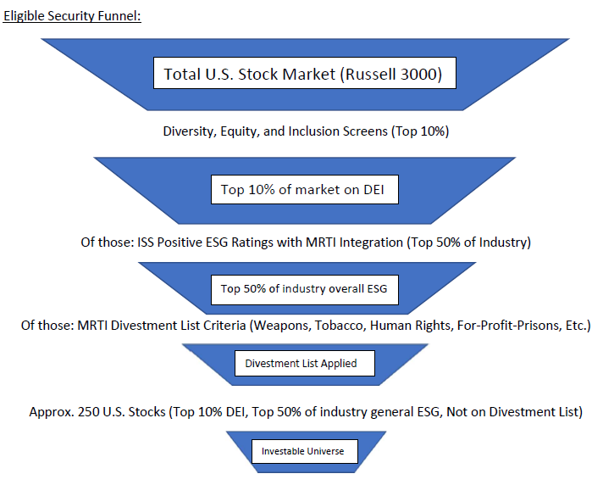
Positive screening for Diversity Equity and Inclusion
Fund structure:
Universe of securities – U.S. Large, Mid and Small Cap (total market universe to begin the screening process).
Application of positive screens to emphasize companies with strong social values aligned with the PCUSA values for diversity, equity, and inclusion.
Application of negative screens for MRTI listed companies.

Slide 9
Positive screening for Diversity Equity and Inclusion
ISS Positive ESG Screening:
The Presbyterian Diversity, Equity, & Inclusion U.S. Stock Index Fund* (DEI U.S. Stock Index Fund) provides exposure to U.S. companies in the top tier of commitment to equal opportunity, non-discrimination, and diversity. This is measured through policies, programs, performance, and impact. The evaluation considers not only diversity, equity and inclusion within the companies own workforce, but also within their supply chains, community involvement, and climate commitments.
* Presbyterian Diversity, Equity & Inclusion U.S. Stock Index Fund is an internal term under development. It doesn't refer to an actual offering at this time. Input is still being gathered for the final ESG Screens.

Slide 10
Positive screening for Diversity Equity and Inclusion
Index Inclusion: The DEI U.S. Stock Index Fund uses a sampling approach to track the U.S. total stock market index. U.S. stocks in the Russell 3000 index are eligible to be considered for inclusion in the DEI U.S. Stock Index Fund. To be included in the DEI U.S. Stock Index Fund, companies must be in the top 10% of all listed U.S. companies (approx. the top 300 companies) in a composite rating which measures the following:
Board & Management Diversity
Non-Discrimination Policies
Measures to Promote Equal Opportunity & Diversity
Supplier Standards- Labor rights & Working Conditions
Supplier Standards- Human Rights - this includes: Conflict Minerals, Right to Clean Water, Indigenous Peoples
Climate Change Strategy
Community Involvement

Slide 11
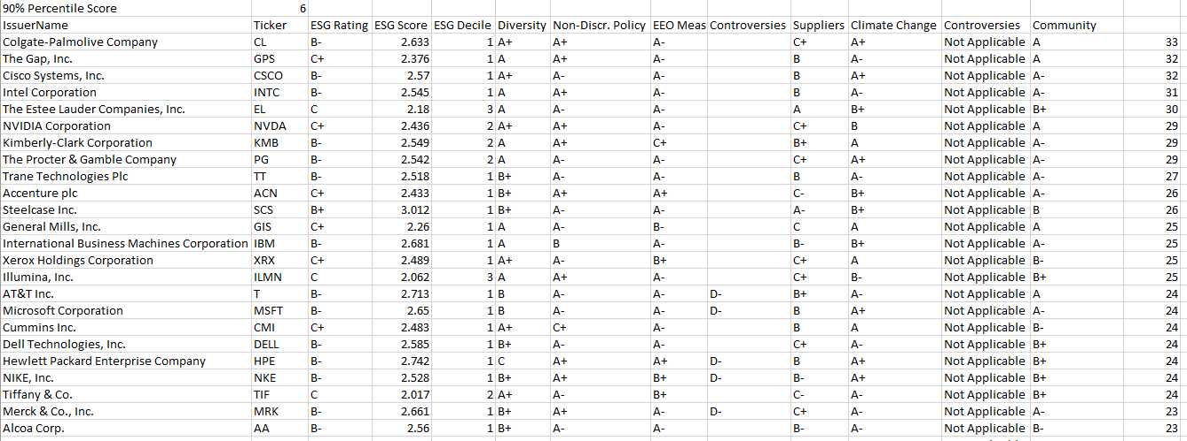
Positive screening for Diversity Equity and Inclusion

Slide 12
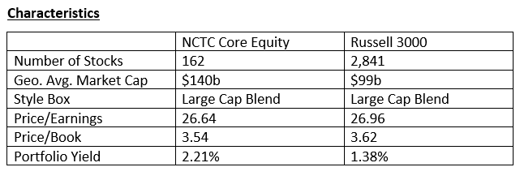
Security & Fund Analysis and Results…

Slide 13
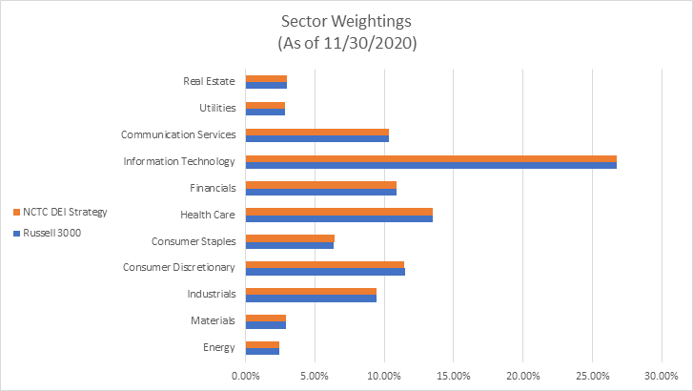
Security & Fund Analysis and Results…

Slide 14
Security & Fund Analysis and Results…
Back Test Examples:
11/30/2020 | YTD | 1 Yr | 2 Yr
DEI + MRTI | 14.06% | 17.40% | 15.08%
Russell 3000 | 13.85% | 16.95% | 15.10%
12/31/2019 | 1 Yr | 2 Yr | 3 Yr
DEI + MRTI | 29.45% | 11.41% | 14.15%
Russell 3000 | 28.54% | 9.34% | 12.42%
The back-testing data should be used for illustrative purposes only. It is not a guarantee of any actual outcome. It is useful for evaluating correlations, index tracking behavior, and expected variance. It is not meant to accurately predict actual performance or alpha. Past performance does not indicate nor guarantee actual future returns. Back testing may include survivorship and other data bias. The full data can be provided upon request.

Slide 15
NCTC Staff
NCTC maintains a well trained and experienced team of professionals that include:
  17 staff who work predominately for NCTC
  2 Certified Public Accountants
  1 Chartered Financial Analyst®
  3 attorneys
  2 Certified Trust and Fiduciary Advisors
  5 Certified Financial Planners™
  2 Accredited Investment Fiduciaries

Slide 16

Diversity Equity and Inclusion

